Slide 1

TIC-TAC-TOE
Submitted in the partial fulfillment for the award of the degree of
BACHELOR OF ENGINEERING
IN
CSE – ARTIFICIAL INTELLIGENCE AND MACHINE LEARNING
Submitted by:
NRIPESH KUMAR
20BCS6465
Under the Supervision of:
Er. Harmandeep Kaur
Department of AIT-CSE
DISCOVER . LEARN . EMPOWER

Slide 2
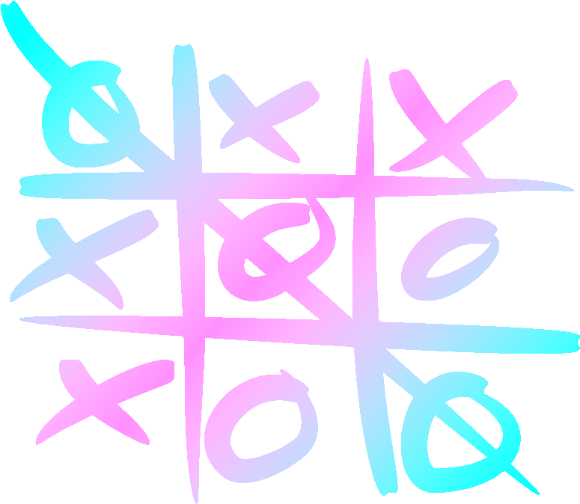
Group 3:
Manpreet Singh : 20BCS6444
Nripesh Kumar : 20BCS6465
Shreya Kohli : 20BCS6451

Slide 3

OUTLINE OF PROJECT
Introduction to Project
Problem Formulation
Objectives of the work
Methodology used
Results and Outputs
Conclusion
Future Scope
References

Slide 4
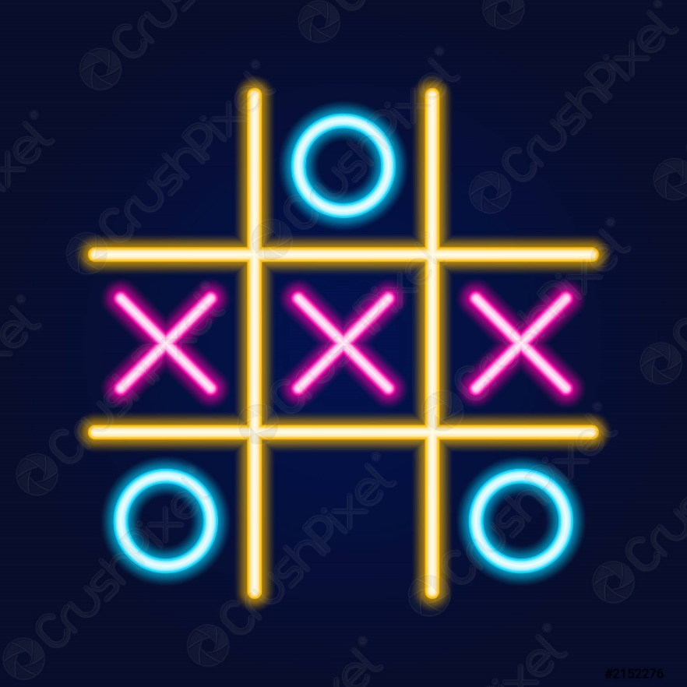
INTRODUCTION
Tic-Tac-Toe is a popular traditional board game which is played between 2 players using a 3 X 3 board.
Each player chooses a symbol – usually a ‘X’ or an ‘O’

Slide 5
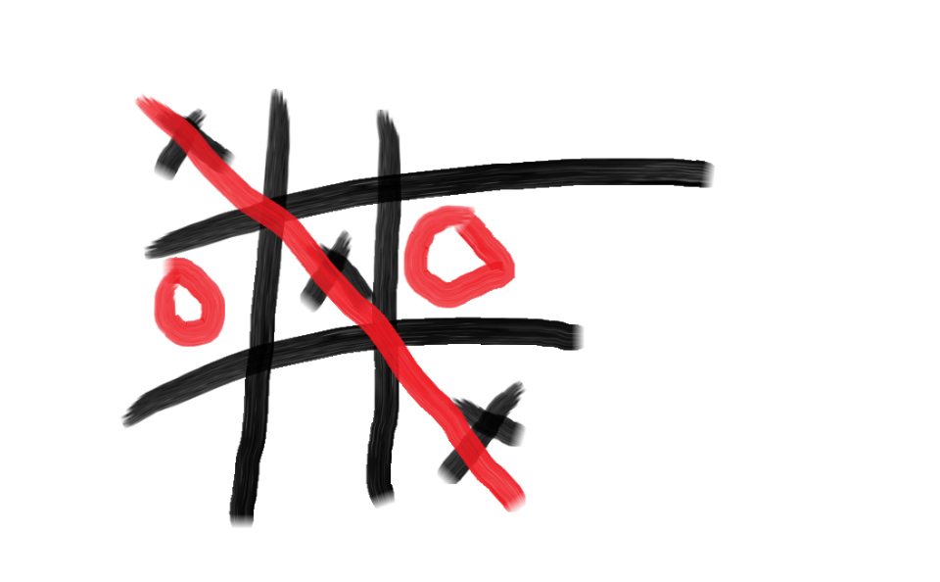
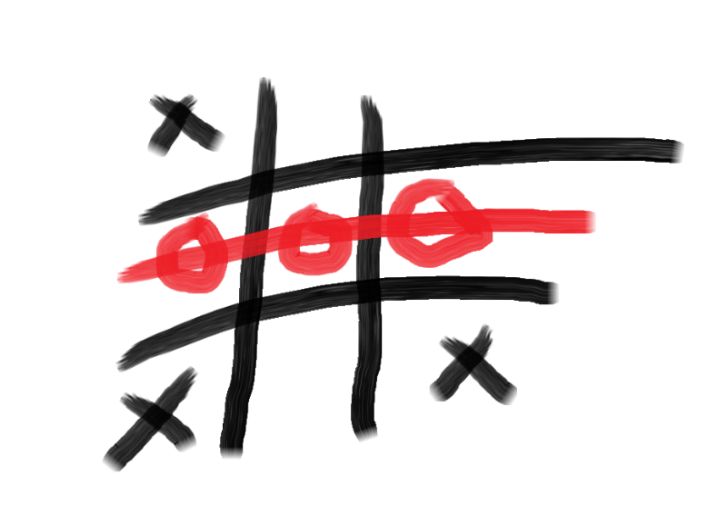
The first player to get three of his or her symbol in a straight line either horizontally, vertically or diagonally wins.
In each turn the aim of both sides is to either strike three consecutive symbols or to prevent other side from doing so. If none of the sides is able to win until the grid is full, the game ends in a draw.

Slide 6

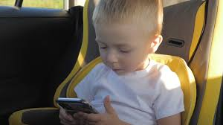
PROBLEM FORMULATION
Tic Tac Toe can be played either at home or on-the-go. It’s great for calming down after some energetic playtime, or to play during travel, and it also works great as a waiting activity.
In the traditional method of playing Tic Tac Toe we needed a pen and paper to play the game and a lot of papers used to get wasted. But by upgrading the game to play it virtually it would prove to be a better alternative.
Moreover, since this game is for two persons, one cannot play it on its own. But since our game has an option of PVP as well as to play the game against a computer, so it doesn’t really matter if one is alone or with a friend.

Slide 7
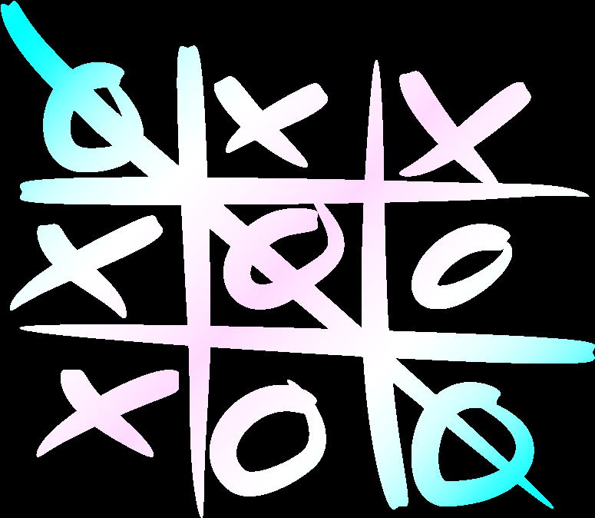
OBJECTIVE
The objective of this project was to change the basic board game Tic Tac Toe to a simpler and advanced version.
In the ‘versus player’ mode, user can challenge another person.
In the ‘versus computer’ mode, we need not only to enable the computer to win but also to prevent the user from winning.
Different difficulty levels for different types of players.
If the player is not satisfied with result he can challenge his opponent for a rematch.

Slide 8
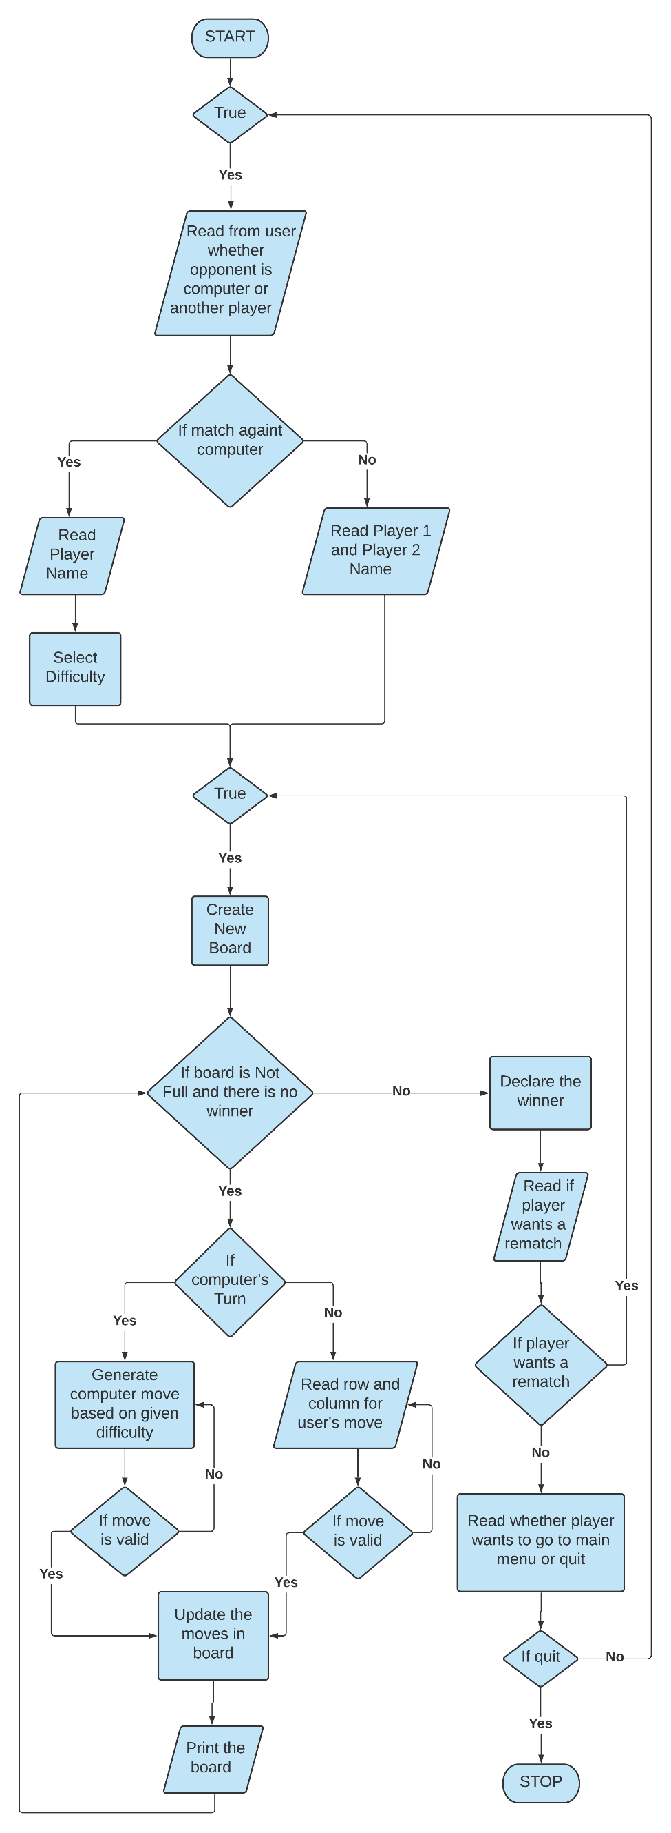
METHODOLOGY

Slide 9


Slide 10
Following functions were used for implementation of tic tac toe game:
1 void createNewBoard(char arr[N][N])
1.1. Creates an empty 3 x 3 board to play the game
1.2. It also prints the new board
2 void printBoard(char arr[N][N])
2.1. Prints the current board with updated moves
3 void userMove( int *userRow, int *userCol , int *stepsWon)
3.1. Reads the input from user for the row or column where he/she want to move
int generateComputerMove (char board[N][N], int * computerRow, int * computerCol, char d);
4.1. It generates a move for the computer based on given difficulty level
5 void compPlaysRandom(char board[N][N], int * cRow, int * cCol);
5.1. Find a random spot for computer to move, considering the spot is valid

Slide 11
6 int compPlaysToWin(char arr[N][N], int *cRow, int *cCol);
6.1. Used to find a spot for computer in case it can win
6.2. If computer can win, it returns 1; otherwise, it return 0
7 int compPlaysToBlock(char arr[N][N], int *cRow, int *cCol);
7.1. Used to find a spot for computer in case it can block user from winning
7.2. If computer can block, it returns 1; otherwise, it return 0
8 bool isInputValid(int a, int i, int j);
8.1. It checks whether the given move is valid or not i.e given row and column is possible and it is not already taken
8.2. Returns 1 in case of valid input, else returns 0
9 bool isGameWon(char arr[N][N], char b);
9.1. Used to check if there is a winner.
9.2. Returns 1 if there is a winner, else returns 0 if no one wins
10 bool isBoardFull (char board [N][N]);
10.1. Check whether the board is full or not
10.2. Returns 1 is case of board is full
11 void computerIsThinking();
11.1. Used to give user an experience that computer is actually thinking and taking time for the next move

Slide 12
12 void intro(string n1, string n2) ;
12.1. Used to keep displaying name and player's symbol at top
13 char gameDifficulty();
13.1. Used to select the game difficulty
13.2. Returns 'e', 'm', 'h' for easy, medium and difficult mode respectively
14 int opponent();
14.1. Used to find if player wants to play with computer or another player
14.2. Returns 1 if computer is selected and 0 otherwise
15 bool wantRematch();
15.1. Used to check if player wants a rematch or not
15.2. Returns 1 if rematch is needed; 0 otherwise
16 void frontPage();
16.1. Used to show the first screen containing the project name and members
17 bool wishToQuit();
17.1 Used to either return to main menu or quit the game
17.2 Returns 1 in case player wants to quit and 0 for returning to main menu

Slide 13
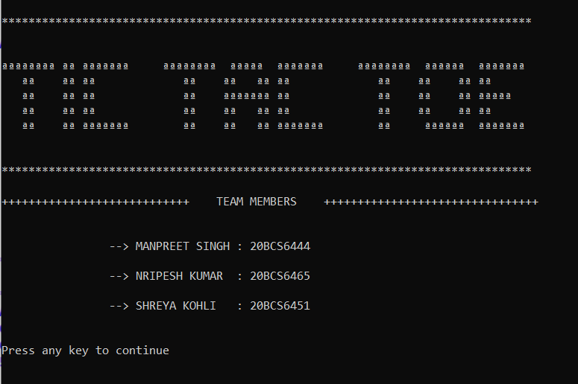
RESULTS & OUTPUT
FRONT PAGE:
This is the first screen that a user sees when he or she runs the program.

Slide 14
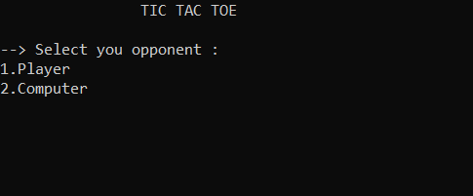
MAIN MENU:
User needs to select whether he needs to play against a computer or another player.

Slide 15
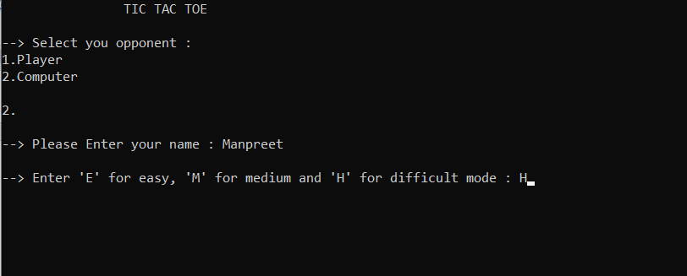
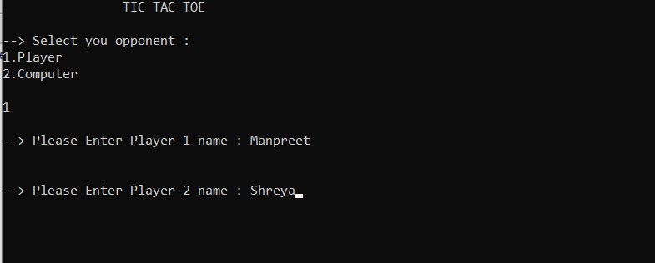
ENTERING DATA (Against Computer):
After selecting computer as opponent, the user needs to enter his or her name and select the difficulty level according to his preference.
ENTERING DATA (Against another player):
After selecting another person as opponent, both the users need to enter their respective names.
OR

Slide 16
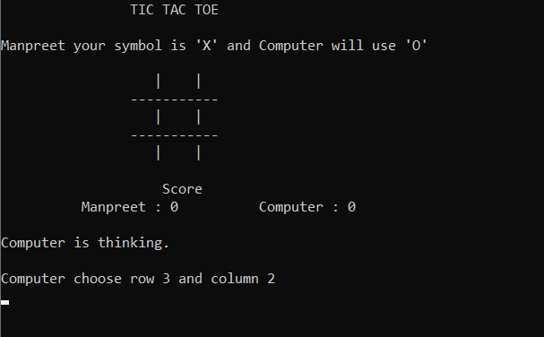
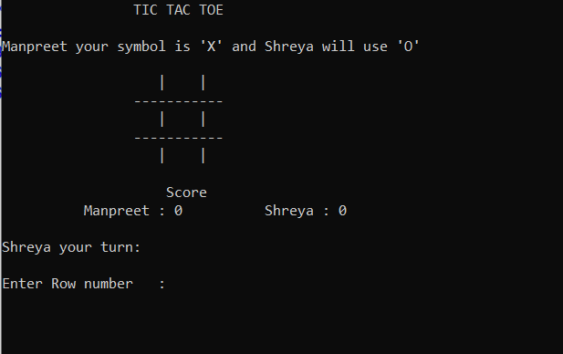
After entering the required data, the game starts like this by displaying the empty Tic tac toe 3X3 grid and score are also mentioned simultaneously.
GAME BEGINS (Against another player):
GAME BEGINS (Against Computer):
OR

Slide 17
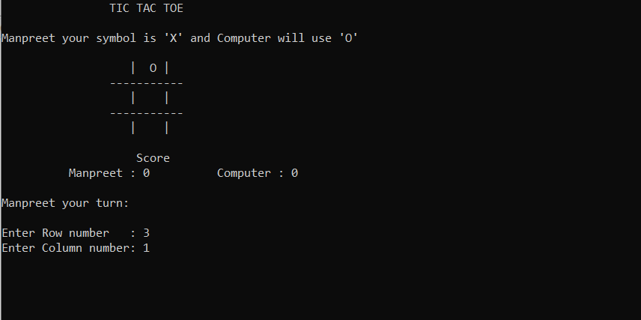
USER’S TURN:
To take a turn user needs to enter the row and column number in which he needs to place his marker.

Slide 18
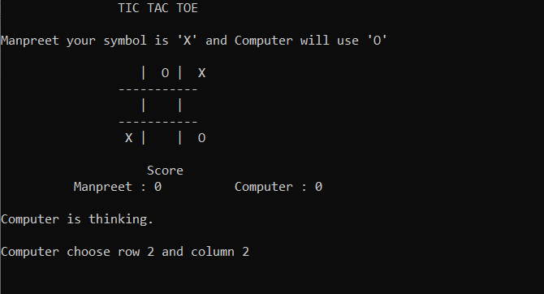
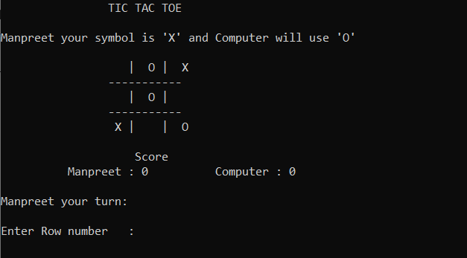
COMPUTER PLAYS TO BLOCK:
Computer had to choose row-2 and column-2 to block the user from wining in next move and it does it successfully by placing its marker on that particular spot.

Slide 19
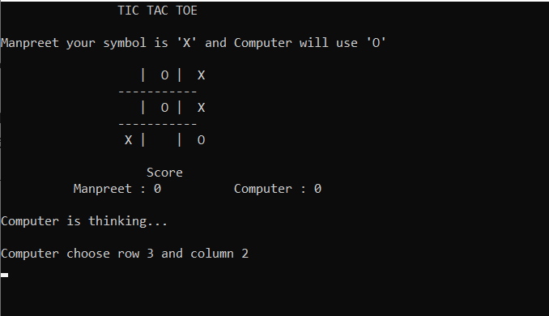
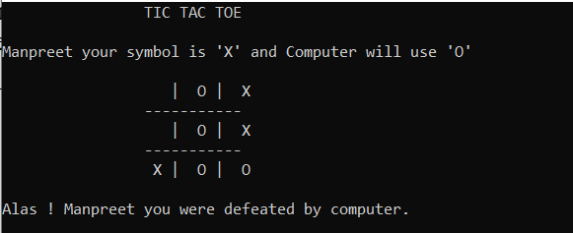
COMPUTER PLAYS TO WIN:
Computer had to choose row-3 and column-2 to win against the user and it does it successfully by placing its marker on that particular spot and therefore defeats the user.

Slide 20
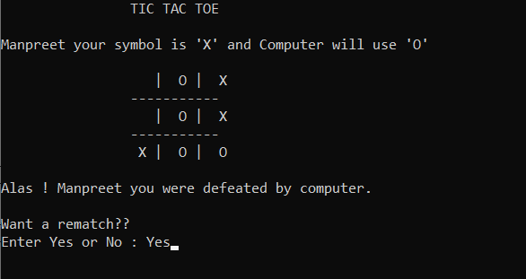
REMATCH OPTION:
When the game is over, the game asks the user if he or she wants a rematch.

Slide 21
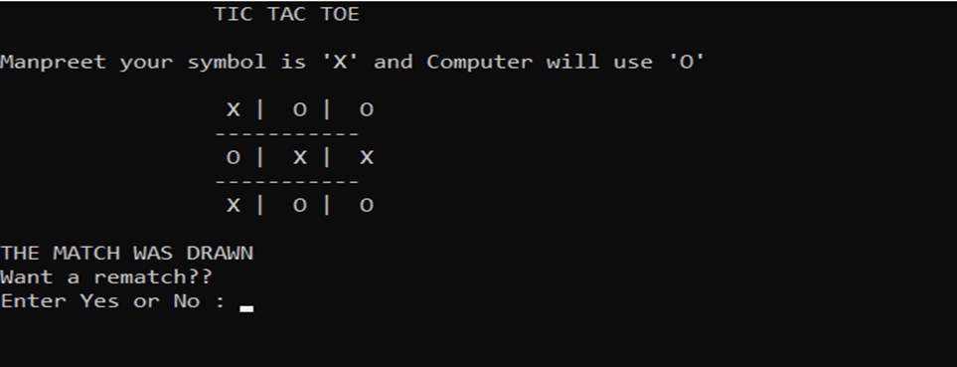
MATCH DRAWN:
When the game is tied, the game asks the user if he or she wants a rematch

Slide 22
CONCLUSION
The Tic Tac Toe game is most familiar among all the age groups. Intelligence can be a property of any purpose-driven decision maker. This basic idea has been suggested many times. An algorithm of playing Tic Tac Toe has been presented and tested that works in efficient way. Overall the system works without any bugs.
Pros:
It can be played as PVP as well as against a computer
Difficulty level of the game can be set according to the user.
Can Keep track of scores.
Cannot win by unfair means.
Cons:
Does not have a GUI, it currently works on console.
Both players need to be on same device to play it.

Slide 23
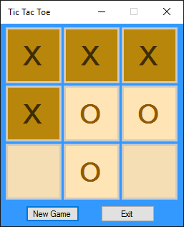


FUTURE SCOPE
Graphical User Interface (GUI) can be added to make the game look more presentable and appealing.
The grid size can be made expandable i.e. not fixed at 3x3.
It can be made to play among multiple devices and not just against the
It can be implemented using Artificial Intelligence.

Slide 24
REFERENCES
https://en.wikipedia.org/wiki/Tic-tac-toe
https://www.thesprucecrafts.com/tic-tac-toe-game-rules-412170
https://www.exploratorium.edu/brain_explorer/tictactoe.html
https://www.geeksforgeeks.org/implementation-of-tic-tac-toe-game/
https://www.geeksforgeeks.org/minimax-algorithm-in-game-theory-set-3-tic-tac-toe-ai-finding-optimal-move/
https://www.geeksforgeeks.org/rand-and-srand-in-ccpp/
https://www.includehelp.com/c-programming-questions/how-to-clear-output-screen-in-c.aspx
https://www.codegrepper.com/code-examples/cpp/c%2B%2B+sleep+function

Slide 25


